Slide 1

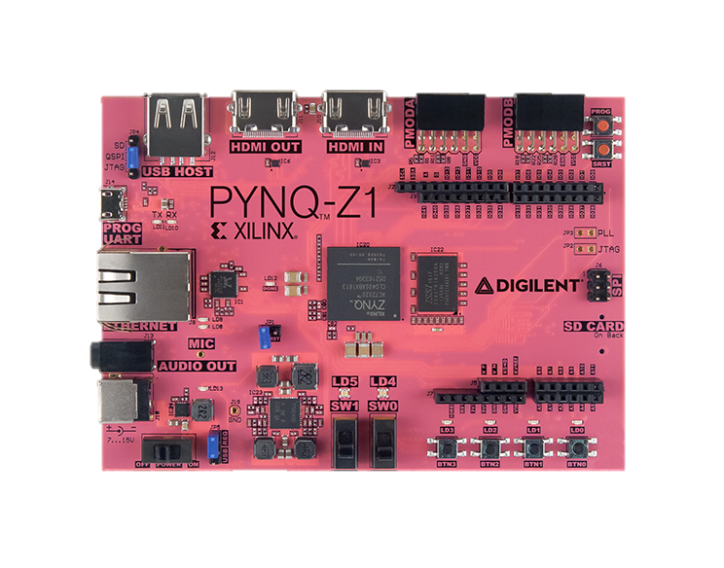
Rendering Fractals using the PYNQ Framework on FPGAs
PYNQ: Python Productivity for Zynq
Zynq System on Chip integrates an ARM processor with FPGA logic
Hardware “overlay” design is used to program the FPGA part of Zynq
Python API interacts with overlay
4th year CES | Student: | Filip Lejhanec
EE475 Project | 1st Supervisor: | Dr Louise Helen Crockett
2018/2019 | 2nd Supervisor: | Dr Alexandra Coddington

Slide 2
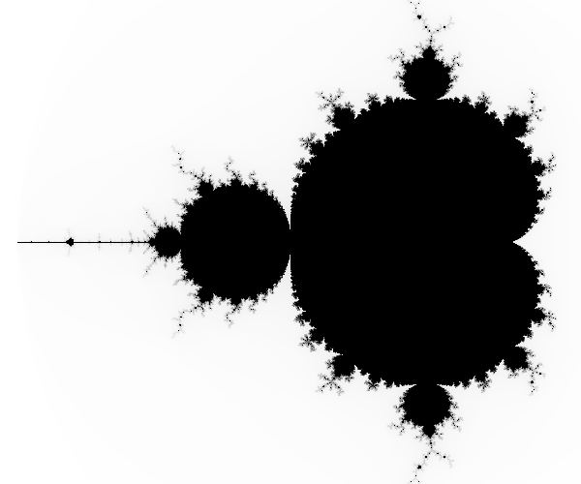
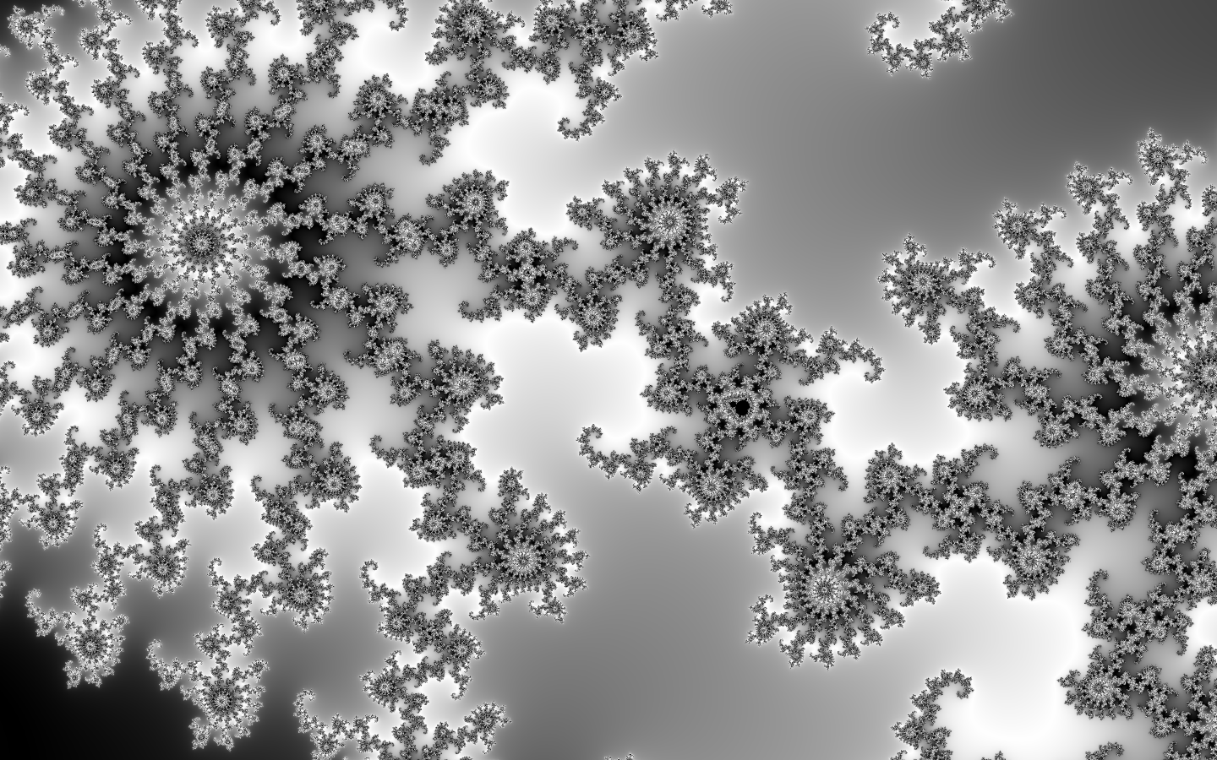
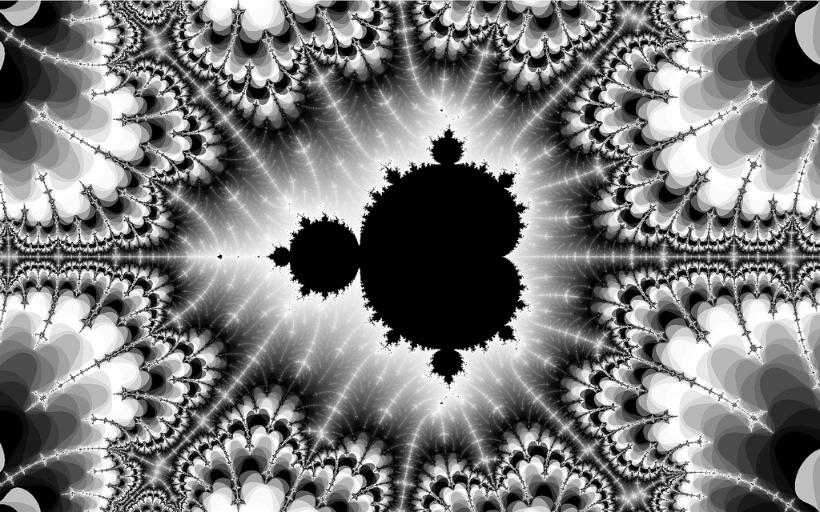
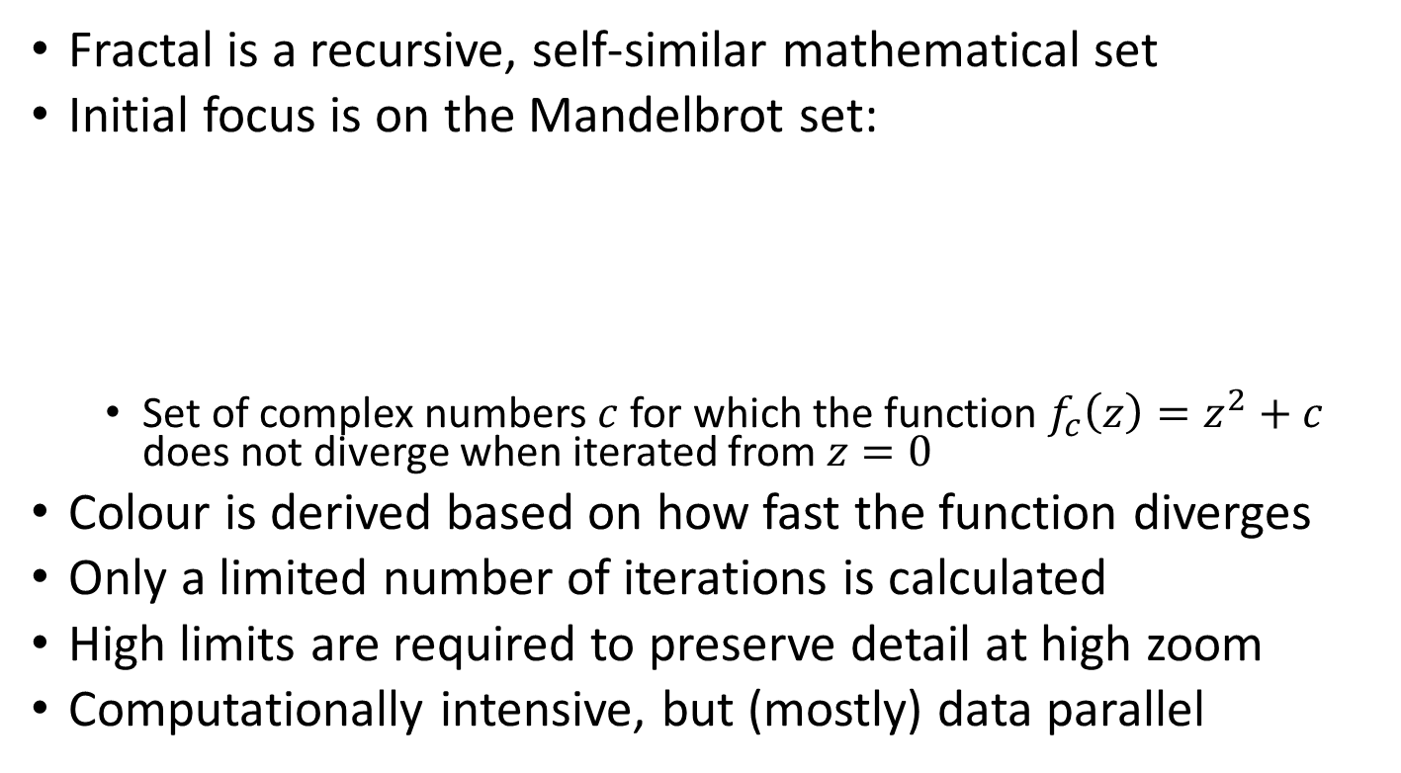
Overview of the Problem
Fractal is a recursive, self-similar mathematical set
Initial focus is on the Mandelbrot set:
Set of complex numbers $c$ for which the function $f_{c}\left(z\right)=z^{2}+c$ does not diverge when iterated from $z=0$
Colour is derived based on how fast the function diverges
Only a limited number of iterations is calculated
High limits are required to preserve detail at high zoom
Computationally intensive, but (mostly) data parallel

Slide 3
System Architecture
PC Monitor
HDMI Monitor
PyQt GUI
SSH Shell
PYNQ-Z1
GPU Renderer
FPGA Circuit

Slide 4


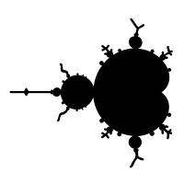
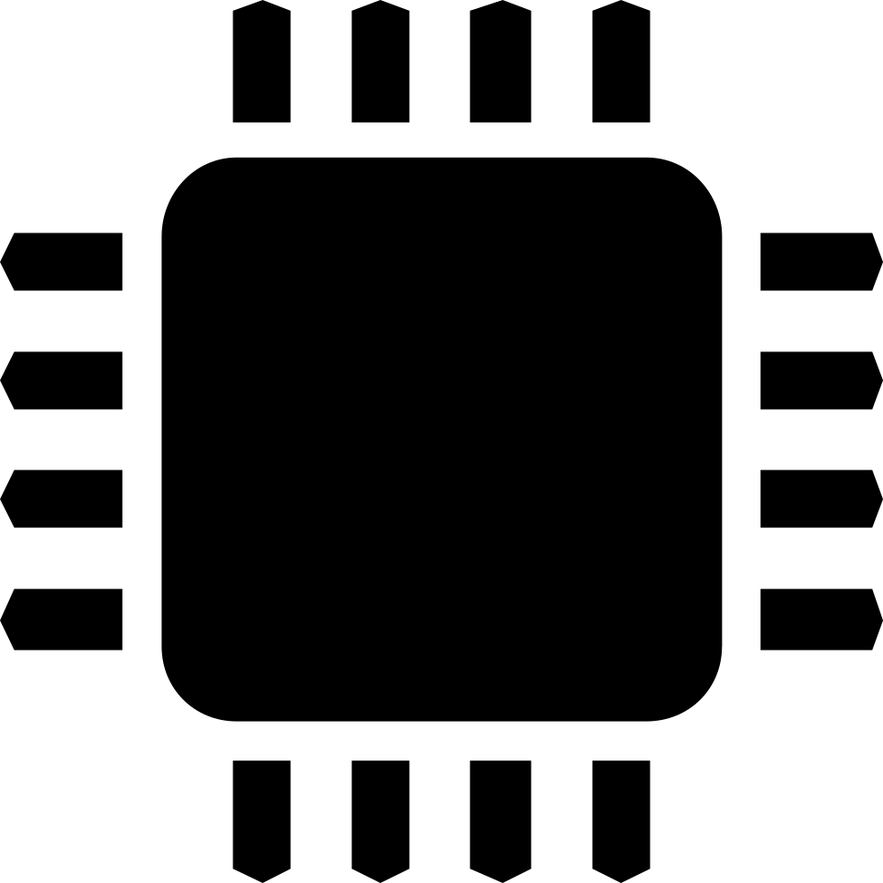
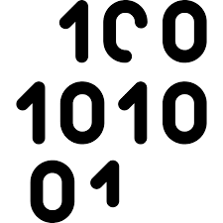
FPGA Architecture
Zynq Processing System
AXI Interconnect
Mandelbrot HW block
Configuration
Colours
Coordinates
Scale
AXI Interrupt Controller
Notify when Finished Processing
AXI Stream MM2S
AXI Video Direct Memory Access
AXI Stream S2MM
Read Pixel Data
Store Pixel Data

Slide 5
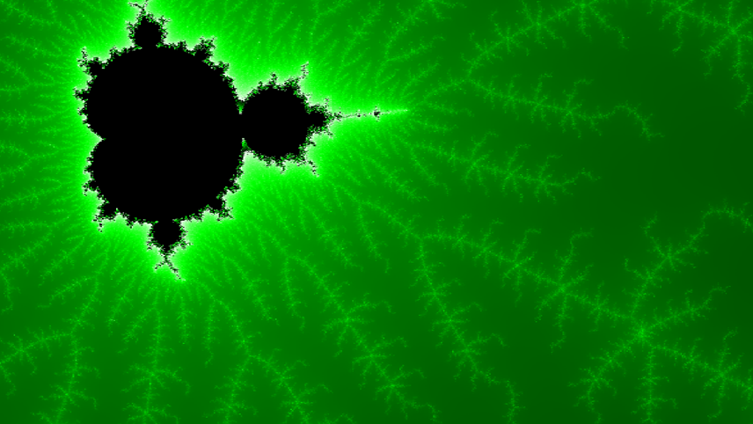

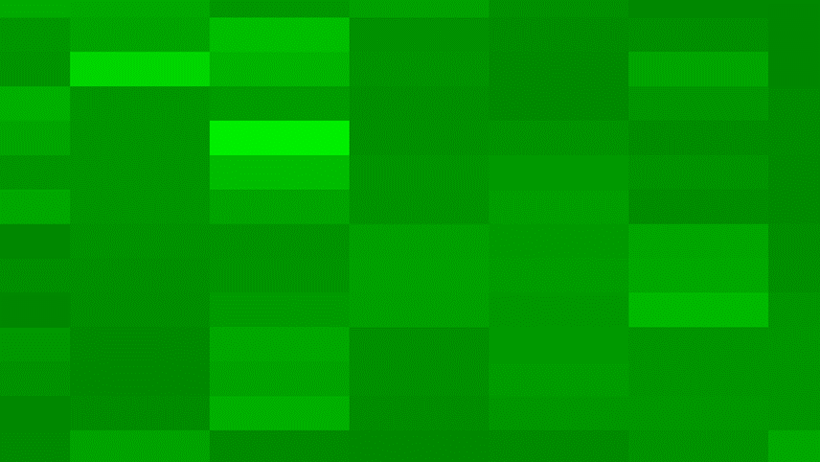
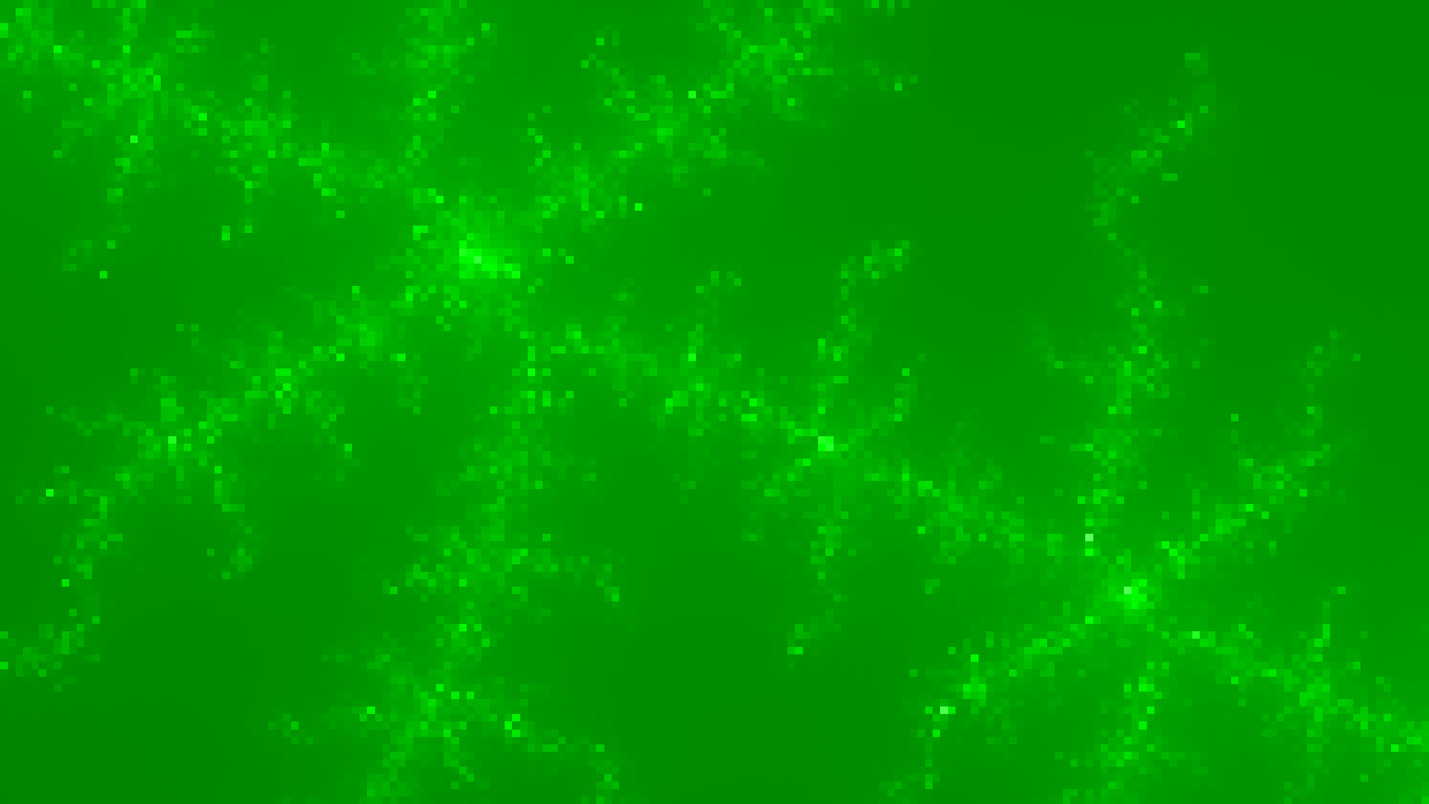
Implementation details
Floating point
vs.
Fixed point
32-bit variables
Fixed point at 4:28
16 parallel processors
FHD output to HDMI
1 frame/second
Customisable
Python API

Slide 6
Render Times of Different IP Implementations

